Slide 1
Resources to Support Reducing Opioid and Gabapentinoid Prescribing In Non-Cancer Pain (DIBS) – 25 September 24
Helen Taylor
Medicines Optimisation Team, Sheffield Place
Various Pain Support websites have been shared in these slides.
SY ICB is not responsible for their content.

Slide 2
DIBS 24.25 – achievement based on March 25
Reduce proportion of patients co-prescribed opioids and gabapentinoids for > 6 months by 10%
Reduce proportion of patients prescribed opioids for > 6 months by 10%
Practices are encouraged to use SNOMED codes:
8B25. = Reducing dose prescribed (182822000) to record where gabapentinoid dose reduction has occurred
Y2b64 = Opioid dosage tapering (287041000000109) where opioid dose has been reduced.
These codes may be on the Ardens Template
Notes:
If a practice currently has 50 patients who are co-prescribed opioids and gabapentinoids for > 6 months to reach the <10% target the practice should have 45 patients or less who are co-prescribed opioids and gabapentinoids for > 6 months
Searches are set up – my understanding is you should know what your baseline is; so you know how many you need to reduce by

Slide 3
How to achieve it!
Any NEW Opioid Prescribing – have a Practice Policy / Share Good Prescribing across The Practice Team.
Review Patients already Prescribed Opioid(s)/ Gabapentinoids
Please let us know if you would like a sample Practice Policy for Opioid Prescribing
Notes:
Baseline data so you should know how many patients need to be stopped

Slide 4
NICE Guidance on Opioids (excl Palliative Care)
(Visual Summaries: NICE (NG215) Before Starting Medication and NICE (NG215) Reviewing Medication)
Chronic primary pain (ICD-11 includes fibromyalgiaand chronic primary musculoskeletal pain) (NG193)
Do not initiate opioids.
Low back pain (NG59) and sciatica (NG59)
Consider weak opioids (with or without paracetamol) for managing acute low back pain only if NSAID is contraindicated, not tolerated, or ineffective. Do not routinely offer opioids for managing acute low back pain. Do not offer opioids for managing chronic low back pain or for managing chronic sciatica
Osteoarthritis (NG226)
Do not routinely offer weak opioids unless: they are only used infrequently for short-term pain relief and all other pharmacological treatments are contraindicated, not tolerated or ineffective. Do not offer strong opioids to people to manage osteoarthritis. Explain risks of strong opioids outweigh benefits
Headaches (CG150)
Do not offer opioids for acute treatment of tension‑type headache, acute treatment of migraine or cluster headache.
Neuropathic pain (CG173)
Do not use morphine or tramadol unless recommended by a specialist. Exception: tramadol may be used only if acute rescue therapy is needed.

Slide 5
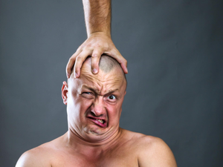
Have a Plan for New Opioid Rx
Immediate Release (IR) opioid – low dose and PRN
Message to patients: save for flare ups and taper after a few days of regular use.
At 3 months review to avoid long-term use.
Reduce dose gradually if taken opioid > 2 weeks.
Resources to share with patients:
Ardens Opioid Template Long-Term Risks (patient Letter) and Opioid Agreement.
Patient information Leaflets: Managing pain after surgery and MHRA: Opioid medicines and the risk of addiction.

Slide 6
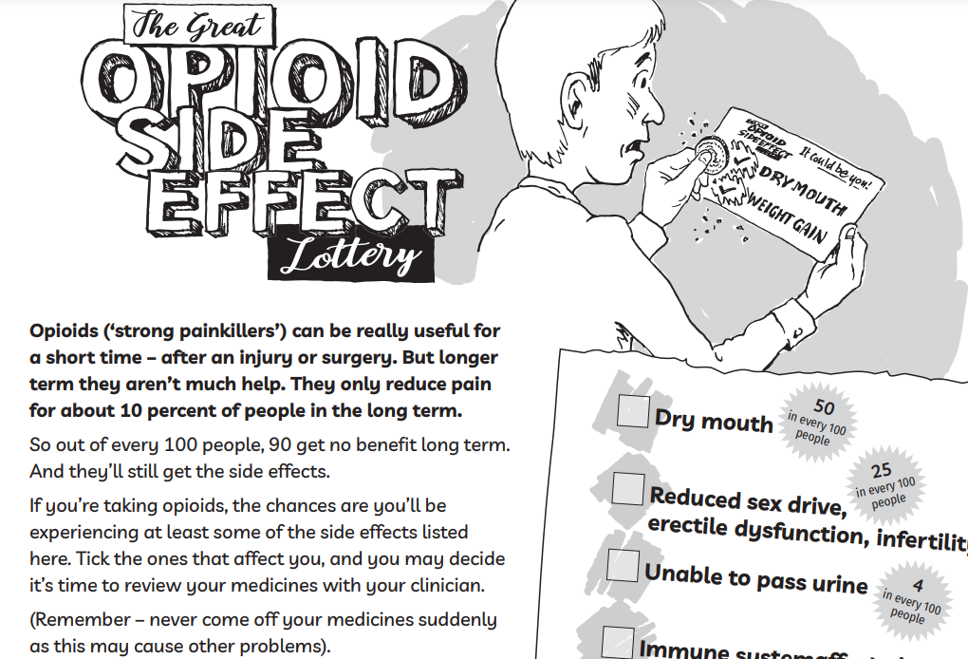
At Reviews: Share risks of opioid side-effects with patients
Share PIL e.g.
Notes:
Older persons focus infections / memory / falls
Young persons focus fertility , sexual dysfunction, depression / weight gain
Pregab weight gain

Slide 7
SystmOne / EMIS searches
Decide on which patients to review, e.g.:
Routinely at ‘annual review’ or ‘targeted opioid review’– Opioid Prescribing Resource-
Consider tapering at least every 6-12 months
to assess benefit and side-effects
‘high risk’ (MHRA alert – severe respiratory depression) or
Indication where opioids not recommended
Patients with more than one opioid Rxd
Which opioid(s) to target ?
Codeine, Tramadol, Morphine, Oxycodone, fentanyl , buprenorphine
includes ‘higher strength’ co-codamol – ie containing ≥ 15mg codeine and ≥ 10 mg dihydrocodeine
Notes:
Can be difficult bringing up a opioid discussion as part of an annual med review. A few targeted med reviews if shared amongst clinicians in the practice hopefully more successful
Got the usual HDO etc as a reason to taper but try to have conversation with patient… you may feel better off them!

Slide 9
Painkillers Don't Exist (painkillersdontexist.com)

Slide 10
PrescQipp – requires log-in. Clinicians across SY can register. https://www.prescqipp.info/ Bulletin 284: Chronic pain and Bulletin 336. Reducing opioid prescribing in chronic pain
Attachment 4 – Text message template
Dear [Title] [Surname],
You have been prescribed a type of medicine called an opioid. For more information on opioids there is a factsheet available here: <ADD LINK TO FACTSHEET>.
The factsheet includes information on what opioids are, how to take opioids, what are the possible side effects, risks and benefits, information on addiction and how to stop taking opioids.
The factsheet also has information on taking opioids during pregnancy, how alcohol affects them and driving whilst taking opioids. There are links to additional information and support groups.

Slide 11
prescqipp.info/umbraco/surface/authorisedmediasurface/index?url=%2fmedia%2fa4sh2n4c%2f7444_opioid_awareness_actor-video-1080p-1.mp4
Notes:
3.5 min video
The PrescQIPP actor video and animation are intended to be viewed by patients to help explain how opioids work, the side effects they can cause, the warning signs to look out for, opioid withdrawal advice and ways to help manage pain better.
They meet accessibility standards:
SY OSG is looking at producing a video but in the meantime you may wish to consider sharing this. There is also an animation version

Slide 12
PrescQipp: Opioid review message
Dear [Title] [Surname],
We are reviewing your current pain relief. In long term pain, using pain relievers called opioids, for more than a few months, has not been shown to be helpful. Your X tablet is an opioid.
Your body can stop sensing the pain-relieving effect, this is called opioid tolerance. It can be an early warning sign that you are at risk of becoming addicted to your medicine.
Opioids can also cause short and long term side effects, such as constipation, reduced fertility, low sex drive, irregular periods, erectile dysfunction in men, reduced ability to fight infection, increased levels of pain known as opioid induced hyperalgesia, increased falls and fractures, depression and fatigue, etc.
If you have been taking your opioid medicine for a long time, do not stop taking it suddenly, this may cause unpleasant withdrawal side effects. It is important to get the right help and support when you are ready to stop taking your medicine.
Please make an appointment with your GP, nurse or clinical pharmacist to talk about the next steps.

Slide 13
SY Opioid Prescribing Resource will be shared shortly
Key message in-line with FPM Opioids Aware: To keep withdrawal symptoms to a minimum:
A decrease by 10% of original dose every 1-2 weeks is usually well tolerated. Individualise, and involve patient in decision.
Can be slower or with smaller reductions. A decrease of 10% every 2-4 weeks may be better tolerated.
Some patients will need space to acclimatise to the new dose so the dose change may be delayed.
Individual Tapering Plans for
Codeine, Morphine, Oxycodone, TD fentanyl and TD Buprenorphine
Notes:
Monthly reduction more likely to suit those Rxd opioid > 1 year or where a 10% reduction isn’t feasible e.g. TD fentanyl.
We recommend considering small amount of morphine IR at the end (after fentanyl 12 mcg) or changing to a buprenorphine patch.

Slide 14
Gabapentinoids:
SYICB_Position_Statement_on_the_Prescribing_of_Gabapentinoids_V1.0.pdf (syics.co.uk)
Consider where there is a lack of evidence or where there is more risk.
Prescribing gabapentinoids for non-neuropathic chronic pain (including low back pain) and sciatica is not recommended due to limited evidence.
Patients already taking gabapentinoids for these indications should be reviewed with a plan to taper and stop as able.
Gabapentinoid_deprescribing.pdf (sheffieldccg.nhs.uk)
Stopping_pregabalin_PIL.pdf (sheffieldccg.nhs.uk)
Stopping_gabapentin_PIL.pdf (sheffieldccg.nhs.uk)

Slide 15
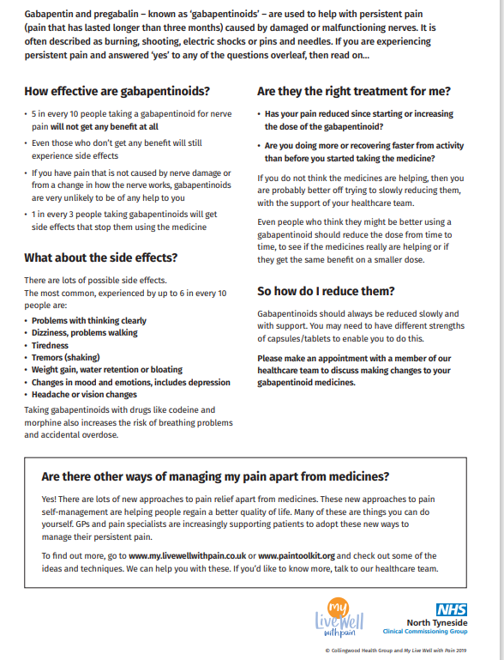
https://livewellwithpain.co.uk/wp-content/uploads/2022/09/ask-yourself-leaflet.pdf

Slide 16
Resources to share with patients
My Live Well with Pain website: Lots of resources to help you learn skills for managing your pain, including: Ten Footsteps towards supporting you to live well with pain. Visit: https://livewellwithpain.co.uk/. Ten Footsteps Programme (information on what it includes: https://livewellwithpain.co.uk/ten-footsteps-programme/) and available as an online interactive guide or a leaflet.
Flippin’ Pain website: Flippin’ Pain™ is a public health campaign with a clear goal: to change the way we think about, talk about and treat persistent pain. Flippin’ your understanding of pain could change the lives of you and your loved ones forever. Visit: https://www.flippinpain.co.uk/

Slide 17
Pain Trainer: This is an online free Pain Management Programme from Australia that helps teach you effective strategies to manage your pain. Visit: https://www.paintrainer.org/login-to-paintrainer/
Pain Concern: This offers resources to support and inform people living with pain, including a: helpline; network forum; radio channel called Airing Pain; and a Self-Management Navigator Tool which can help you to recognise all the different ways in which pain affects you. Visit: https://painconcern.org.uk/
The Pain Toolkit: Pain self-management is about learning new and using old skills and trying them out to see what works for you. Visit: https://www.paintoolkit.org/
Retrain Pain: Short 1 min videos on pain, mind and goals, sleep, medication and relationships. Available in 23 different languages. Visit: https://www.retrainpain.org/

Slide 18
NHS Chronic Pain Self-management: Includes advice on importance of keeping active; links to different exercises (including chair exercises); pain medication; and a 20 minute guided meditation proven to help people cope with chronic pain. Visit: https://www.nhs.uk/live-well/pain/ways-to-manage-chronic-pain/ and https://www.nhs.uk/live-well/
NHS Fife Jigsaw: toolkit with information on specific areas of self-management https://www.nhsfife.org/media/0dhkipaz/pain-jigsaw-interactive3.pdf
ESCAPE-pain (https://escape-pain.org/) is a group rehabilitation programme for people with chronic joint pain that integrates educational self-management and coping strategies with an exercise regimen individualised for each participant. It is produced in the NHS and the programme can be accessed online: https://escape-pain.org/support-tools/escape-pain-online/
Social Prescribing: https://www.thejoyapp.com/

Slide 19
Videos Understanding Pain:
Brainman: A five-minute explanation of chronic pain by the Hunter Integrated Pain Service in Australia. There is a follow up video called Brainman stops his opioids. https://www.tga.gov.au/chronic-pain-management-video-resource-brainman
Tame the Beast. A good explanation of how your mood can affect pain: Tame the Beast
Podcasts: The Lorimer Moseley Podcast: Pain Matters
Apps: Back Pain: Chartered society of physiotherapy has a helpful video on back pain: https://www.csp.org.uk/publications/10-things-you-need-know-about-your-back
Advice About Sleep: Sleepio is available free on the NHS for all adults nationwide. https://onboarding.sleepio.com/sleepio/nhs/391#1/1 and for anxiety: https://www.bighealth.co.uk/daylight.

Slide 20
Doncaster Place:
Doncaster Pain Management unit in DBTH - https://www.dbth.nhs.uk/services/pain-management-2/
Chronic pain peer group - https://welldoncaster.uk/for-me/peer-support/chronic-pain-peer-groups
Rotherham and Doncaster Talking therapies: https://talkingtherapies.rdash.nhs.uk/
NHS talking therapy, includes counselling, CBT support - https://www.yourlifedoncaster.co.uk/mental-health
Health & wellbeing support - https://www.yourlifedoncaster.co.uk/wellbeing
Get Doncaster moving - https://getdoncastermoving.org/

