Slide 1
Greener Prescribing in Diabetes
Developed by
SYICB Primary Care Development Nurses
Jackie Elliott Diabetes Consultant at Sheffield Teaching Hospitals
The Yorkshire and the Humber Environmental and Sustainability Group (NHSE)
Notes:
Standard title slide

Slide 2
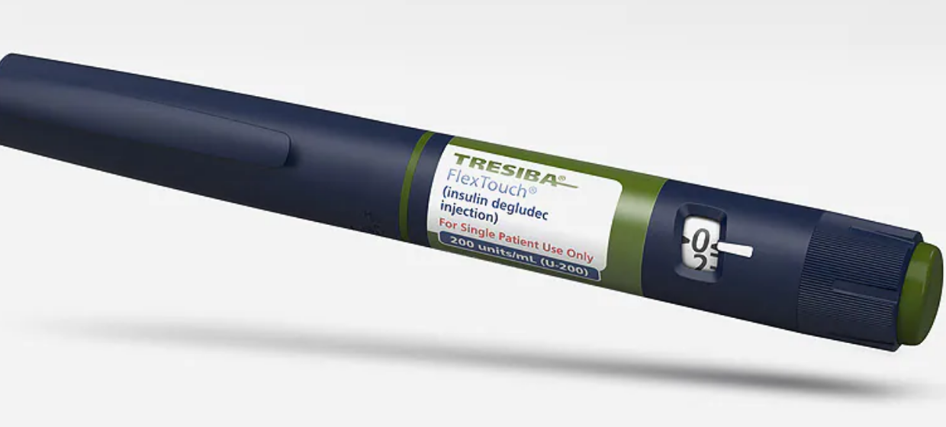
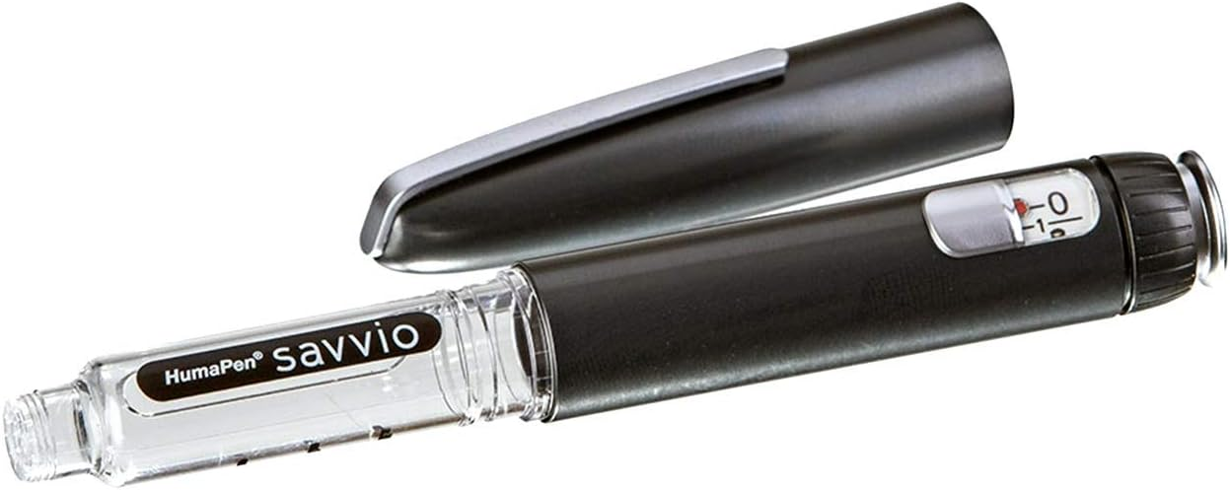
Why consider being greener?
Insulin is prescribed all the time but are we thinking enough about the environment ?
Think about what the impact is of the use of disposable pens……
Notes:
Plain slide with subhead and bullets

Slide 3
Pen options for Insulin Users
Disposable pens
Reuseable cartridge pens
These pens are only used once.
Environmentally unfriendly as the plastic waste is far greater for this device.
The whole pen is placed in the yellow sharps bin as the pen cannot/should not be dismantled.
If there are dexterity issues patients may be better with this pen than a re-usable. If this type of pen is required, patient should be advised to recycle where possible.
NOVO - Pens Home | PenCycle (pen-cycle.co.uk)
Sanofi - Pens https://www.mysanofiinsulin.co.uk/repen/
Reusable pens last for several years so less plastic is needed for manufacture of the device.
Patients simply unscrew and add/change the insulin penfill cartridge.
Only the small glass penfill cartridge needs to be changed and disposed of in the yellow sharps bin taking far less space in the bin.
Less packaging & less plastic waste than disposable pens.
Some reusable cartridge pens have Smart Technology that shows when the last dose was given and more.
Notes:
300 units in a standard disposable pen – so if a T2 is on 40 units a day this is lasting just over 3 days….

Slide 4
Comparing Carbon Footprints of Insulin Pens
Impact on Environment Per Patient | Reusable Cartridge Pen(Novo 6) and needles and insulin | Disposable Novo Flex Touch Pen, needles and insulin | How many times greater impact on environment of using disposable pens
Carbon Footprint | 7kgCO2 –eq./yr | 11kg CO2 –eq./yr | 1.6 x Greater
Plastic Footprint (inc Package) | 0.47 kg plastic/yr | 1.30 kg plastic/yr | 2.8 x Greater
Novo rapid is the insulin included in the figures above.
Adapted from Novo Nordisk (2021)
NovoPen 5/6 incl. Penfill and needle, product carbon footprint, version 3.2 [Accessed via product-carbon-footprint-novopen5-6.pdf (novonordisk.com) last accessed 10/1/24]
FlexTouch incl. API and needle, product carbon footprint, version 3.2 [ Accessed via product-carbon-footprint-flextouch.pdf (novonordisk.com) last accessed 10/1/24]
Notes:
Plain slide with subhead and bullets

Slide 5
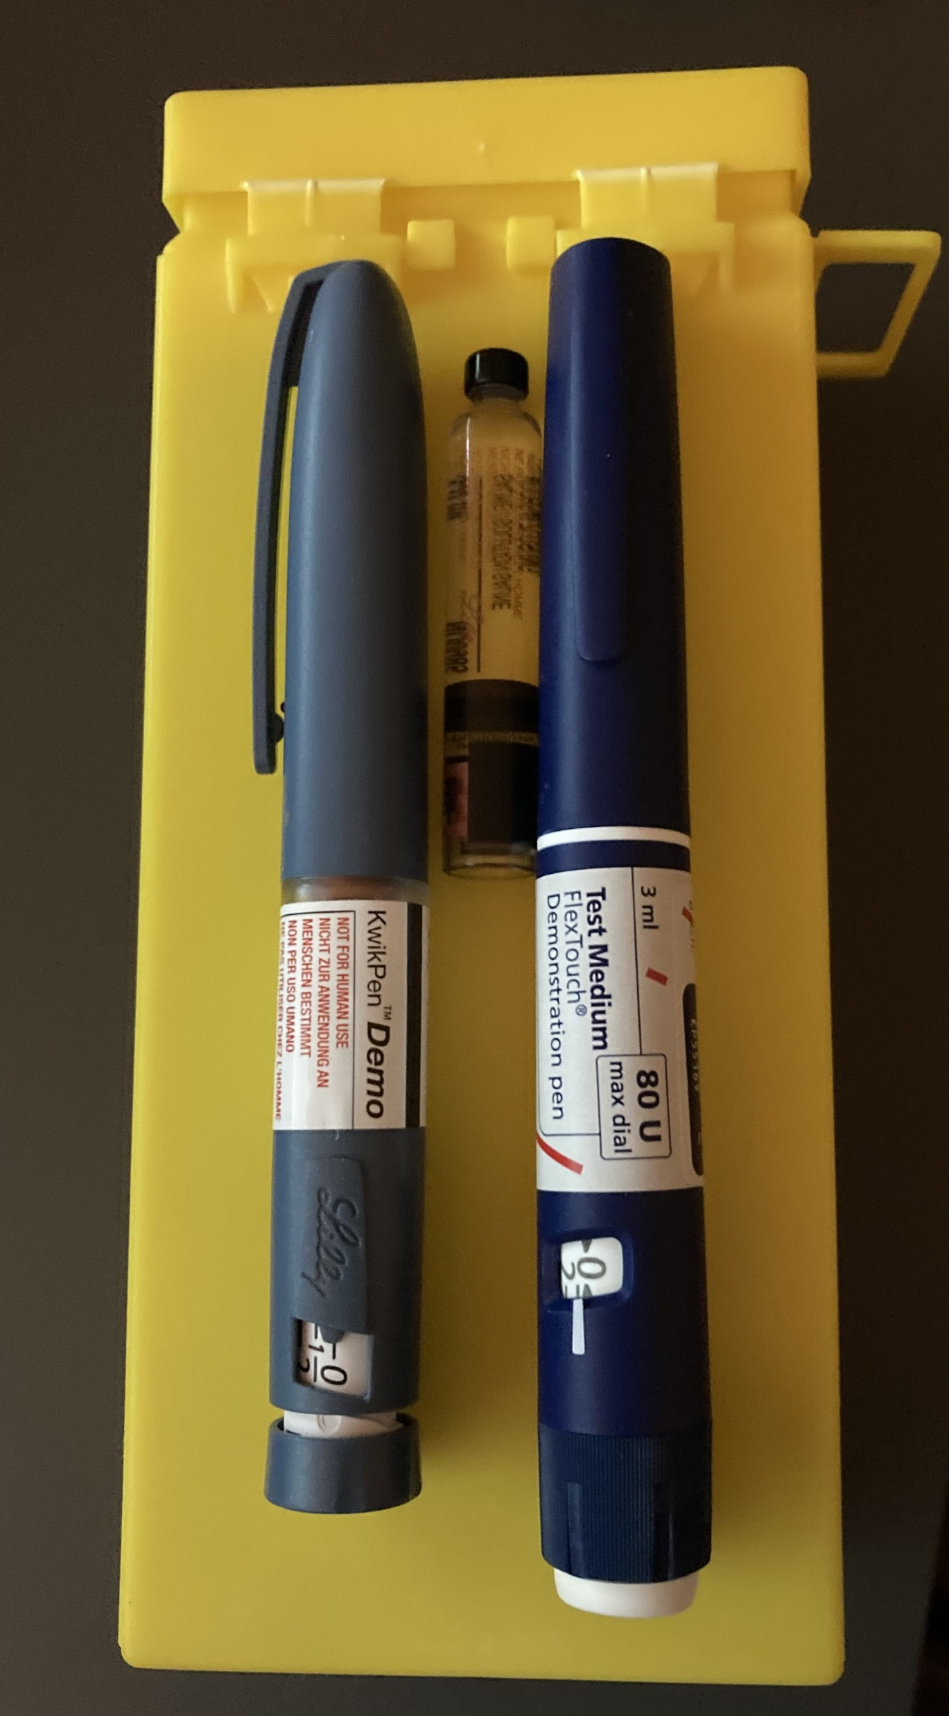
Which produces more waste?
How many pens do you think could fit in this mini sharps bin? Maybe 6?
How many Cartridges Maybe 26? Whatever size bin, pens take up at least 4x more space
What do we do with sharps bins?
Flex- Touch Disposable Pen or kwikpen | Penfill Cartridge
28 grams (empty) | 5 grams (empty)
Sharps bins are charged by weight!
If I used 48 Units BD – a pen would last me 3 days – I would be throwing away over 120 insulin pens a year Filling 20 x 0.5 L sharps bins and creating approximately 4 KG of plastic waste that will be burnt…………. Is this a good idea?
Notes:
By filling sharps bins faster we are creating yet more plastic waste – remember the issue of disposal of more sharps bins means greater impact on environment

Slide 6
Environmental benefits of cartridge pens
Use less Plastic - Cartridge pens last years
Reduce sharps bins use
Impact of Transportation
Use less fridge space (saves on electricity)
Reduce amount of packaging
Notes:
Plain slide with subhead and bullets

Slide 7
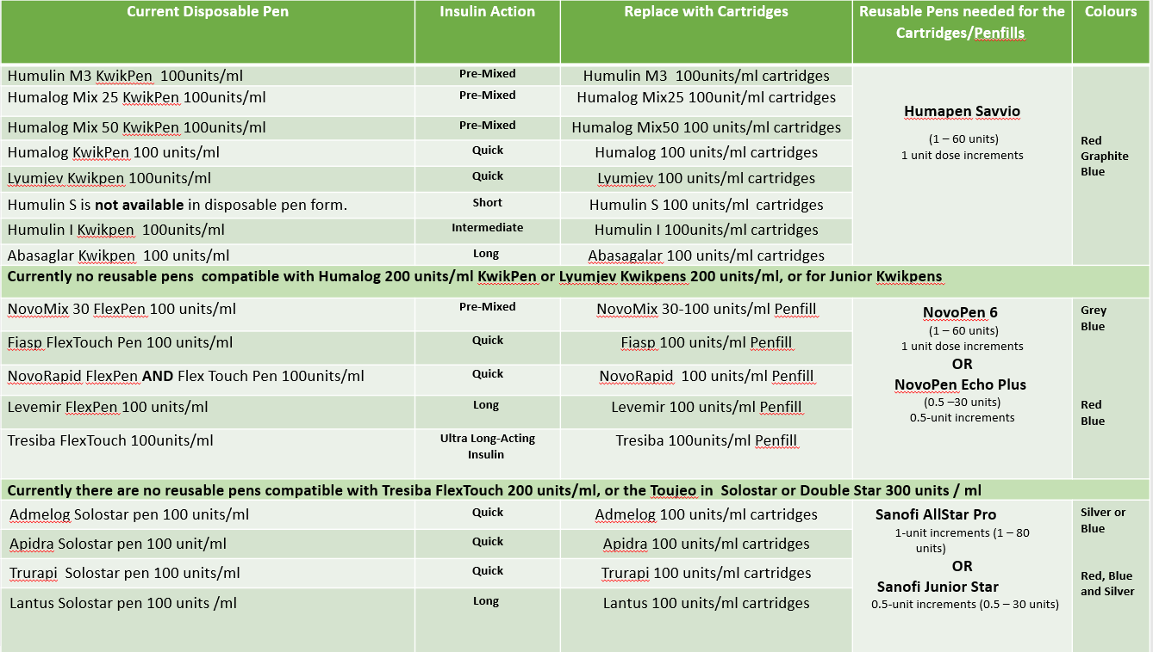
Making the switch from disposable. Which insulin cartridge for which re-usable pen
This chart was developed from Jackie Elliott (STH original chart) and a final resource produced with support of the Yorkshire and the Humber Environmental and Sustainability Group (NHSE). This is a reference guide ONLY – NOTE any prescribing decisions should always be based on current guidelines and local prescribing advice referring to SPC as needed.

Slide 8
Build confidence to switch
Get sample pens and feel confident in using them before you speak to patients about switching, or sit in with your local Diabetes Specialist Nurse.
Be aware of life expectancy of cartridge pens ALL STAR PRO (3-yr life span) and Junior Star (2-yr life span), NOVO 6 & NOVO ECHO (Expected battery life 4-5 years, 3 Years Warranty) and Humapen Savvio (6 years intended use)
Check out these links for hints: Novo Nordisk, Sanofi and Lilly
Watch this video by Sheffield Community Diabetes Specialist Nurses How to switch to cartridge Pens with the Sheffield DSNs
Remember only switch if you are confident – ask your local DSN for support if in any doubt.

Slide 9
Be aware of the proper use of cartridges
NEVER draw up insulin into a syringe from a pen device or cartridge.
This is dangerous as creates an infection risk and potential dosing errors.
Cartridges as the name suggests should be administered only via an insulin cartridge pen of the same brand.
Notes:
Plain slide with subhead and bullets

Slide 10
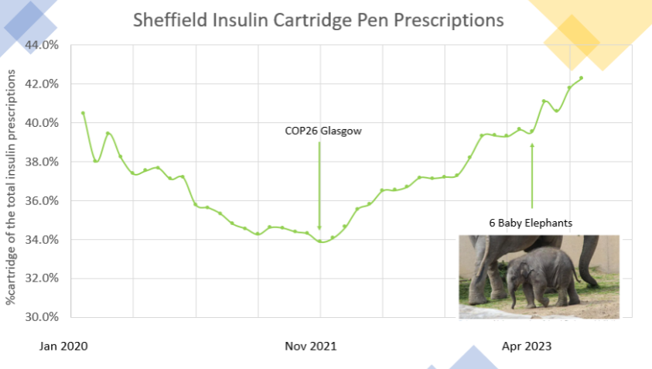
Sheffield is turning the tide on environmentally unfriendly insulin prescribing
In 2021 Sheffield Teaching Hospitals Diabetes Centre began to switch suitable patients from disposable to cartridge pens
This reversed the decline in cartridge prescriptions across Sheffield place
By April 2023 the amount of plastic waste saved was equivalent to the weight of 6 baby elephants !
cartridge pens as a % of the total insulin prescriptions
Notes:
Plain slide with subhead and bullets

Slide 11
Beyond insulin - Greener choices in diabetes
Think about avoiding patients stock piling
Needles/Ketone strips/Blood sugar Strips all go out of date – check at reviews
If a patient needs to be on disposable pen and on large doses check out If there is a concentrated or higher volume pen (less waste)
Don’t allow cartridge pens to be repeat dispensed, ensure the patient has one in use and one in event of breakages
Check at annual reviews that each patient has 2 cartridge pens
Notes:
Plain slide with subhead and bullets

Slide 12
Summary
Prescribing reusable cartridge pens results in lower:
Carbon and plastic Footprint
Other Greener decisions can be made by:
Avoiding over prescribing of insulin and other products
Being mindful of expiry and encourage stock rotation
However:
Only suggest switching a patient to a reusable cartridge pen if it’s the right thing for them.

Slide 13
Resources
Check out the following links which I can add to the chat.
Greener Prescribing Page - For Sheffield
How to get sample pens, insulin pen charts, hints and tips including video links and also details of recycle schemes
2 Sided chart specific for Doncaster can be sent out on request as the one above has Sheffield formulary for needle information
PCDN training sessions
Practice Team Hub (sharepoint.com) for other diabetes training options including healthy eating, pancreatic diabetes, Q & A with Sheffield DSNS and GLP1 update
Notes:
Plain slide with subhead and bullets

